Slide 1
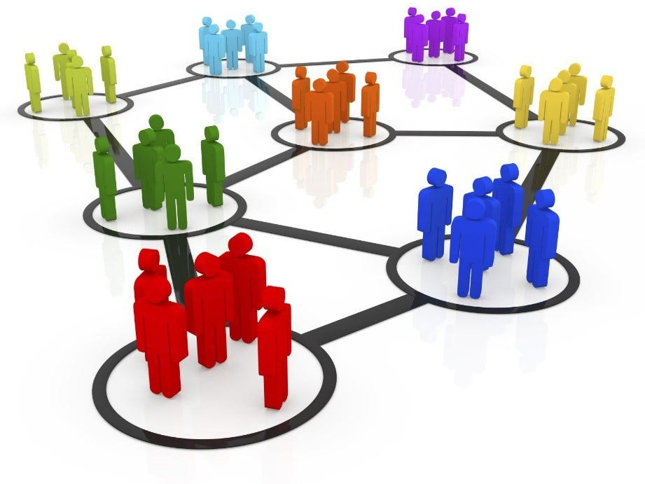
CUSTOMER
SEGMENTATION
using K-Means clustering

Slide 2
INDEX
Introduction
About K-Means clustering
Existing system
Drawbacks of existing system
Proposed method
Results
Applications
Advantages
Conclusion
References

Slide 3
INTRODUCTION
Customer segmentation is the process of dividing a customer base into distinct groups with shared characteristics or behaviors.
This strategic approach allows businesses to tailor marketing efforts, enhance customer satisfaction, and optimize overall engagement by understanding and catering to the unique needs of each segment.
The common characteristics for dividing customers are like demographics ,geographical location,behavioural,socio-economic and psychological aspects.
It is an important market strategy used often by growing companies

Slide 4
ABOUT K-MEANS CLUSTERING
K-Means Clustering, clusters the data into different groups in the unlabeled dataset on its own without the need for any training.
The 'K' referring to the number of clusters. It is a unsupervised centroid-based algorithm, where each cluster is associated with a centroid, and the clusters are obtained by minimizing the sum of Euclidian distances between datapoint and corresponding cluster.
The algorithm takes the unlabeled dataset as input, divides the dataset into a k-number of clusters, and repeats the process until it does not find the best clusters. The value of k should be predetermined in this algorithm.

Slide 5
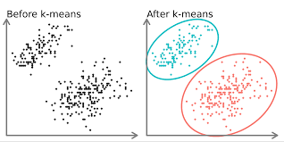
fig-k-means clustering

Slide 6
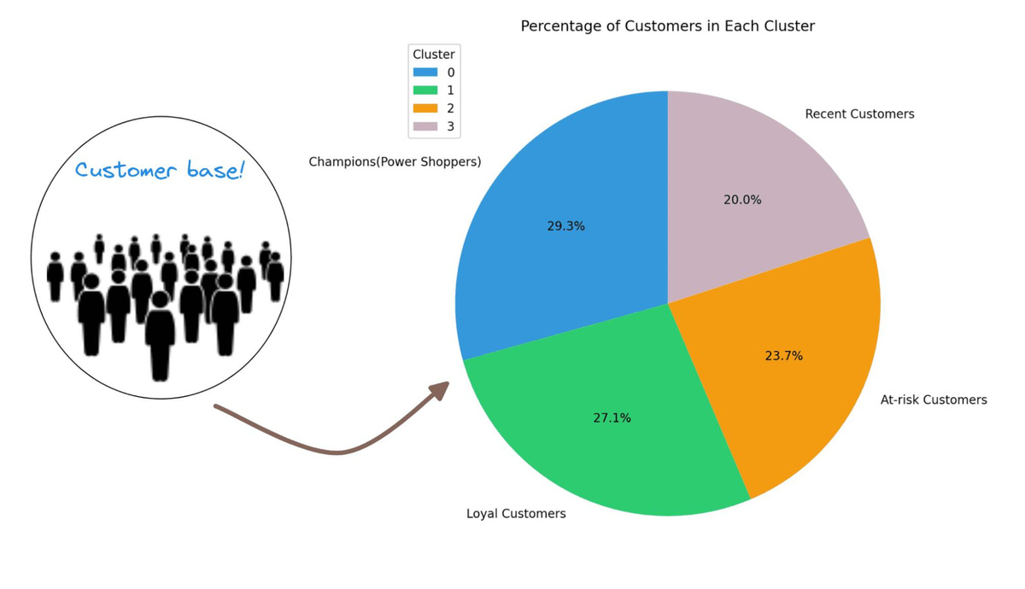
EXISTING SYSTEM
In the existing system the analysis and segmentation of the customers was done by visualizing the graphs by clustering the two or more feature. Using the basic graphs analysis can be done up to some data.

Slide 7
DRAWBACKS OF EXISTING SYSTEM
Data Points are overlapped.
The data does not hold some patterns.
Data clusters were Inappropriate for accurate considerations.

Slide 8
PROPOSED METHOD
In the proposed system to get accurate result we used K-Means Algorithm was applied.
In K- Means the data points were grouped accurately depending on the value of k the no. of clusters were identified.
To find optimized k value Elbow method is used.

Slide 9
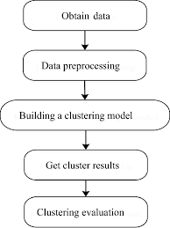
proposed method flow chart

Slide 10
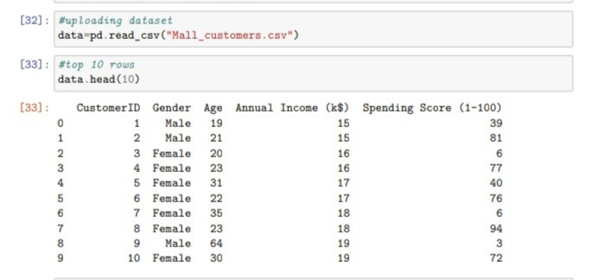
RESULTS
Uploading dataset :

Slide 11
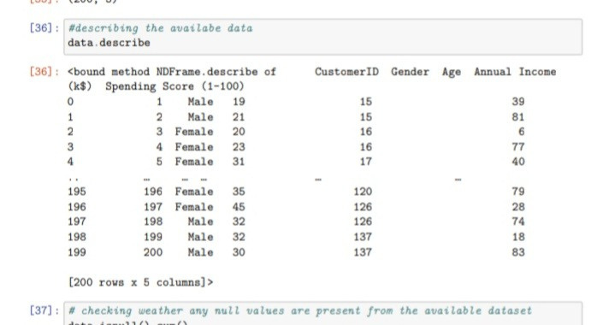
Data preprocessing:

Slide 12
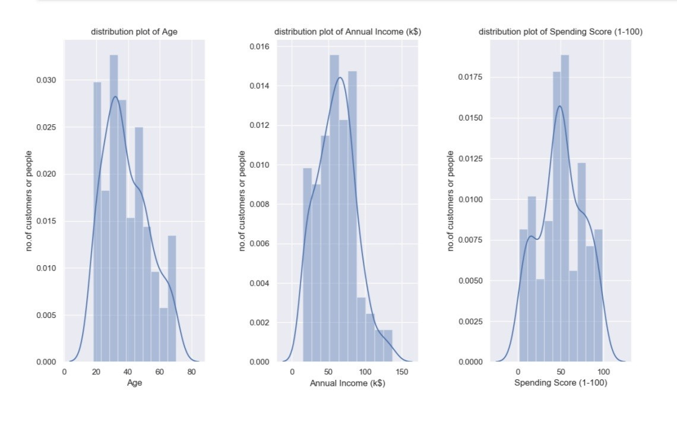
visualisation of Age,Annual Income (k$),Spending Score (1-100):

Slide 13
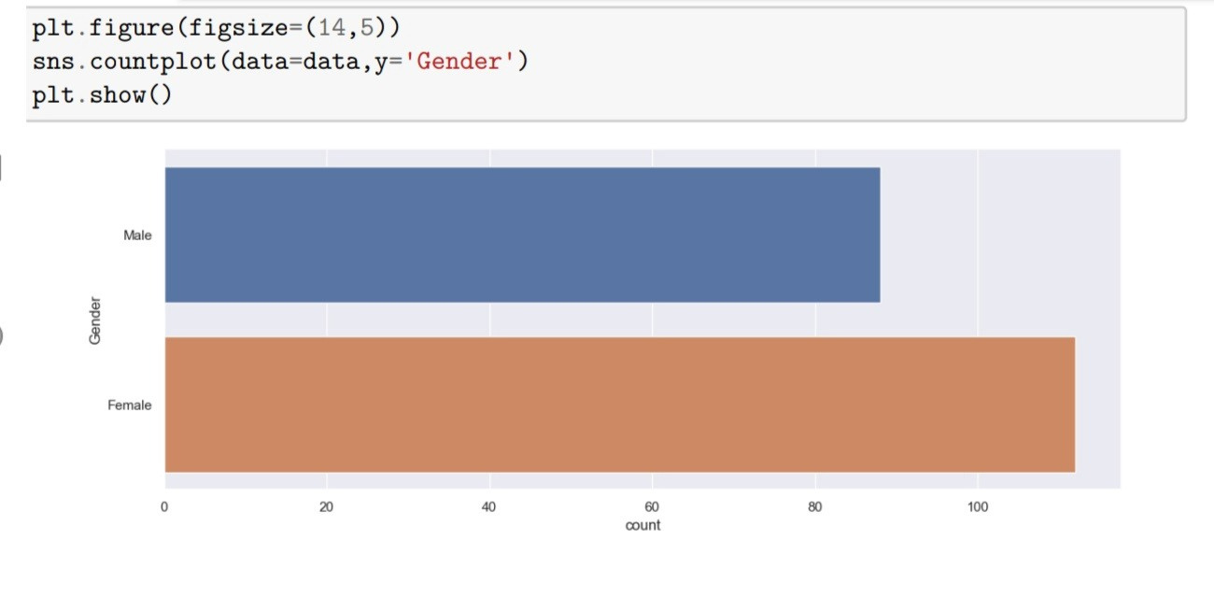
Gender countplot:

Slide 14
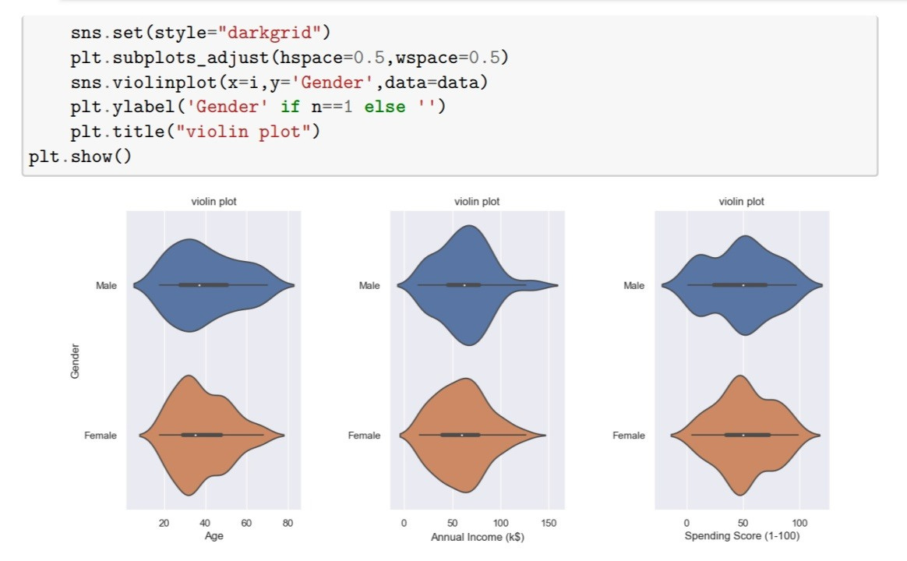
Gender comparission using violin plot:

Slide 15
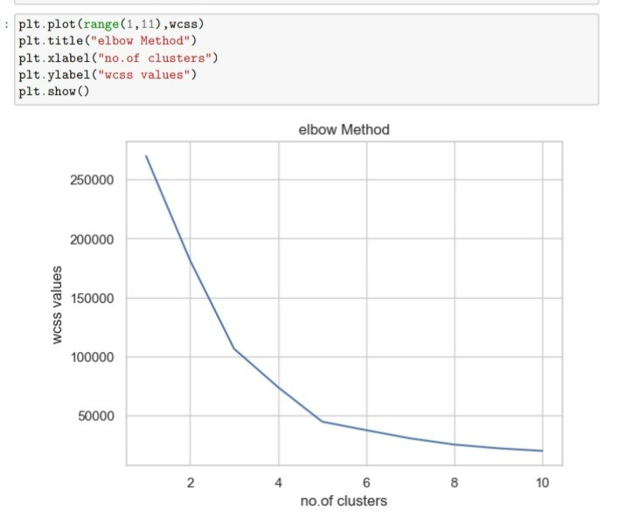
Elbow Method:

Slide 16
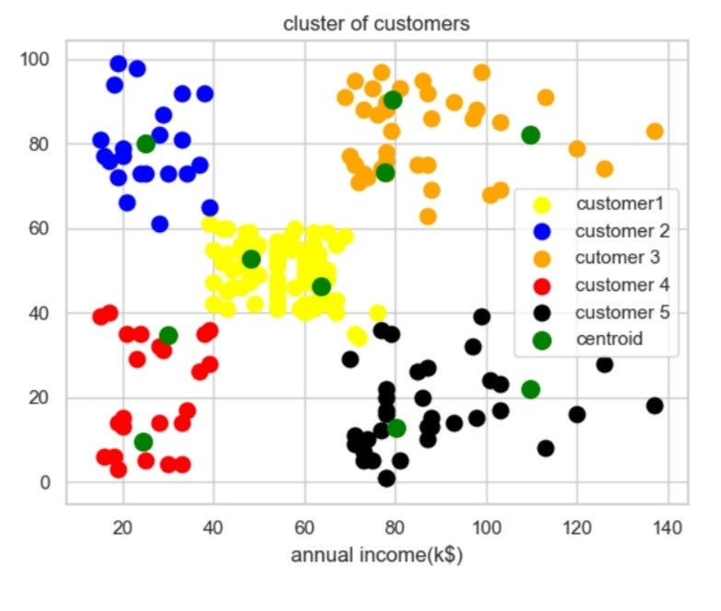
K-Means clustering graph:

Slide 17
APPLICATIONS
Targeted Marketing
Product Development
Pricing Strategies
Market Expansion

Slide 18
ADVANTAGES
Targeted Marketing
Better Decision-Making
Develop customized marketing campaigns
Design an optimal distribution strategy

Slide 19
CONCLUSION
Cluster 1: high income and low spending score; ask them for feedback and advertise them with new products that might attract them, they have the potential to convert into
Cluster 2: low income and high spending scores; can help them by providing new deals and sales offers so that despite low income they still remain loyal.
Cluster 3: high spending scores and high-income; alert them with new arrivals as they are potential customer for increase in revenue.
Cluster 4: low income and low spending score; it won’t be beneficial to both the parties to target these customers
Rest are average and the company can use them according to market

Slide 20
REFERENCES
Al-Qaed F, Sutcliffe A. Adaptive Decision Support System (ADSS) for B2C E Commerce. 2006 ICEC Eighth Int Conf Electron Commer Proc NEW E-COMMERCE Innov Conqu Curr BARRIERS, Obs LIMITATIONS TO Conduct Success Bus INTERNET. 2006:492-503.
Mobasher B, Cooley R, Srivastava J. Automatic Personalization Based on Web Usage Mining. Commun ACM. 2000;43(8).
Cherna Y, Tzenga G. Measuring Consumer Loyalty of B2C e-Retailing Service by Fuzzy Integral: a FANP-Based Synthetic Model. In: International Conference on Fuzzy Theory and Its Applications iFUZZY.;

Slide 21
THANK YOU

